Slide 1


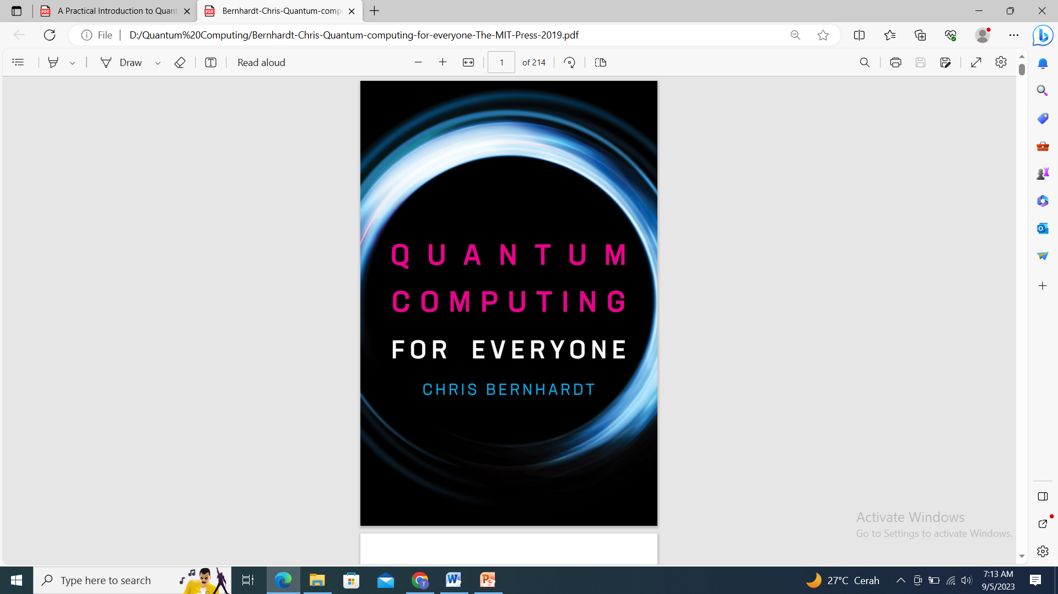
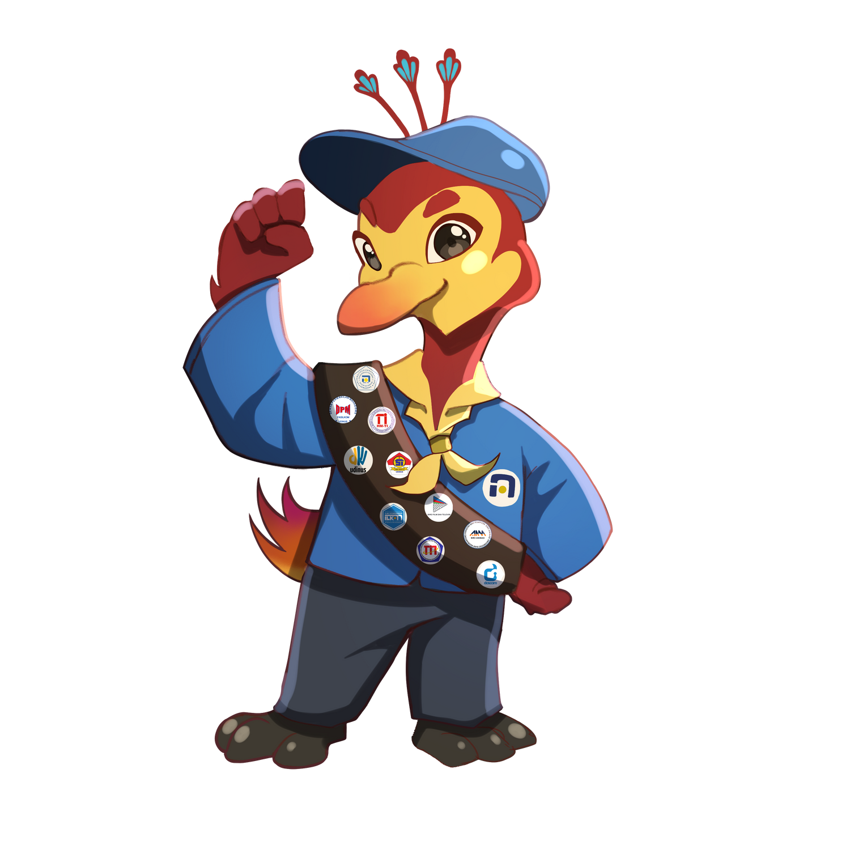
Quantum Gates and Circuits

Slide 2
MATERI
Cbit vs Qubit
Representasi dan Pengukuran Qubit Tunggal
Representasi dan Pengukuran Qubit Ganda
Operasi Pada Qubit Tunggal
Operasi Pada Qubit Ganda

Slide 3
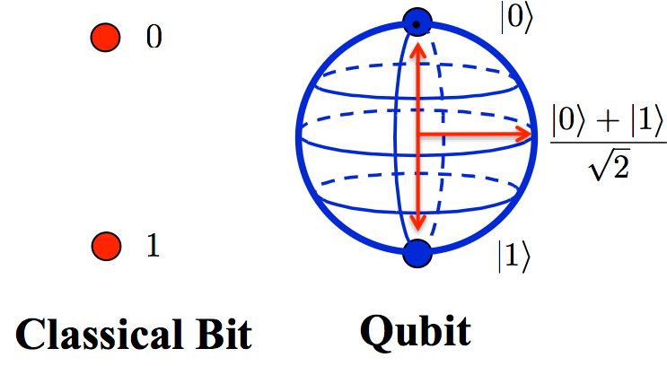
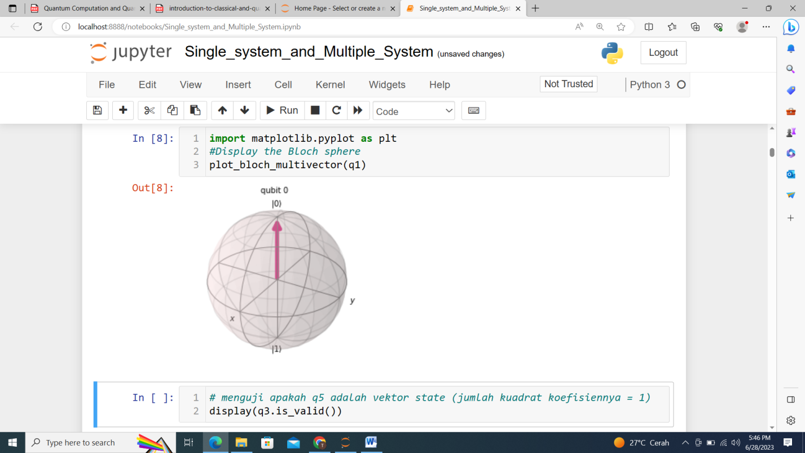
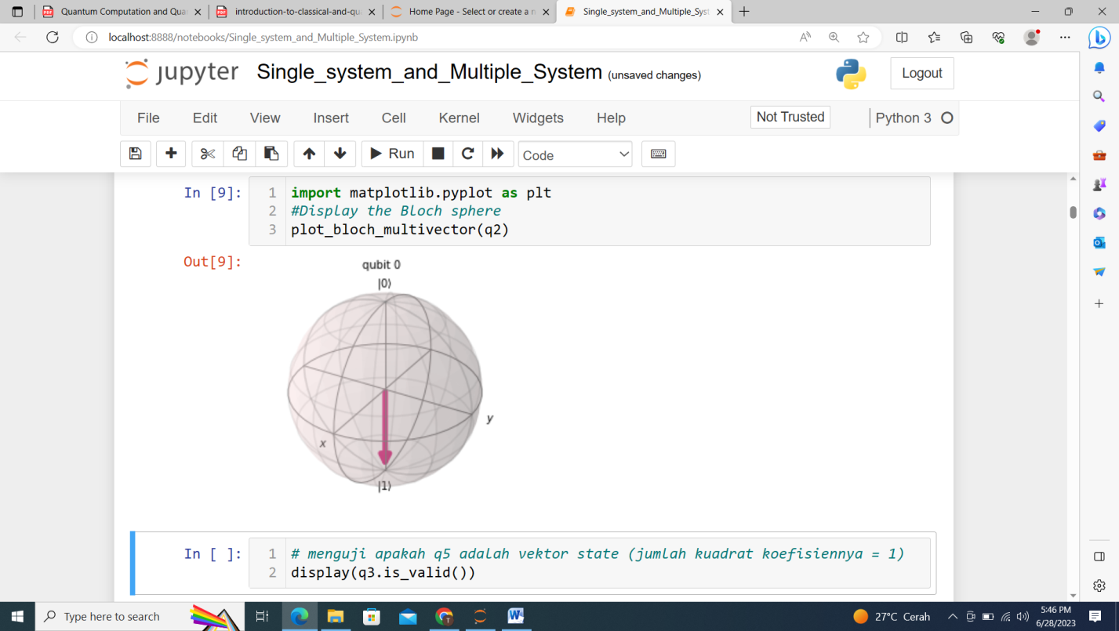

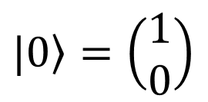
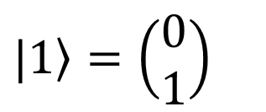
Cbit vs Qubit
Bloch Sphere
$\left.|0\right\rangle =\left(\begin{matrix}1 \\ 0\end{matrix}\right)$
$\left.|1\right\rangle =\left(\begin{matrix}0 \\ 1\end{matrix}\right)$

Slide 4
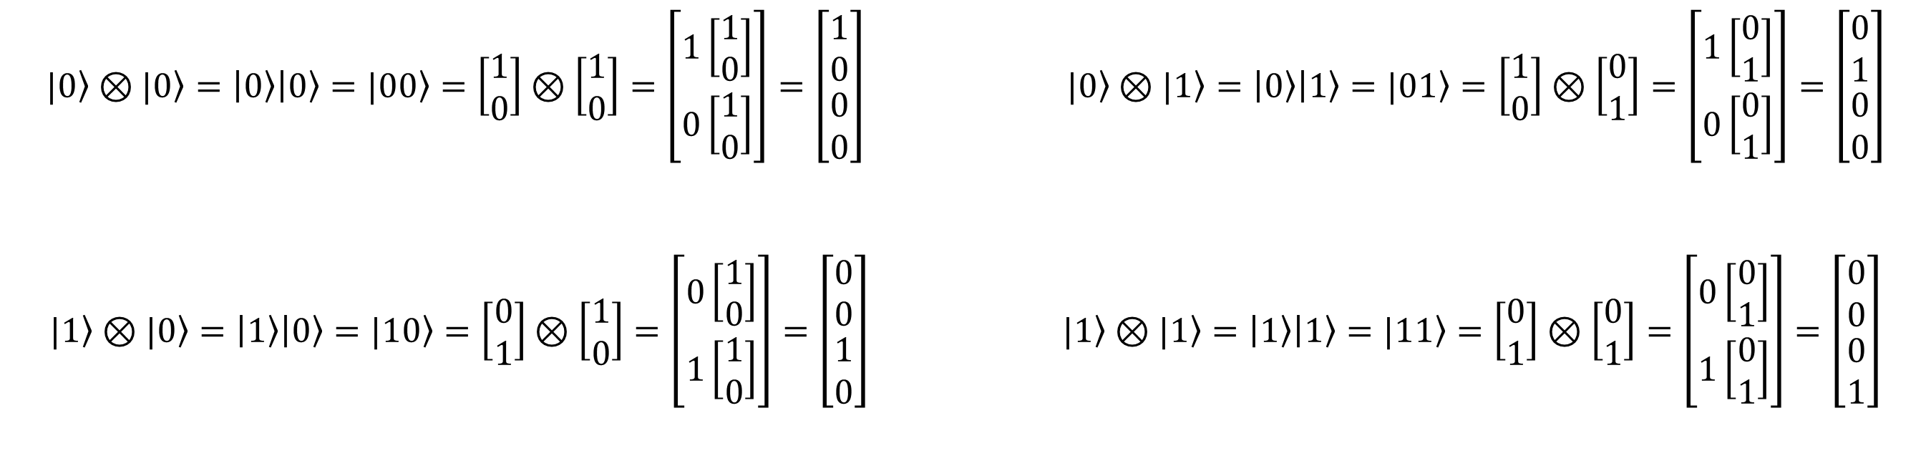
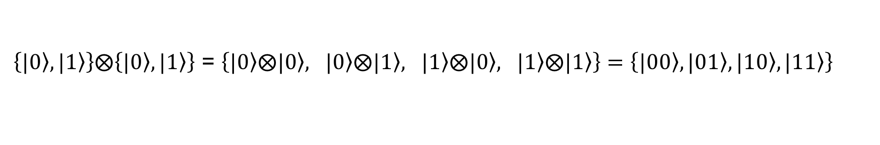
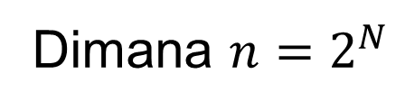
Basis States
Qubit Biner Desimal
1-Qubit $\left\{|\left.0\right\rangle ,|\left.1\right\rangle \right\}$ $\left\{|\left.0\right\rangle ,|\left.1\right\rangle \right\}$
2-Qubit $\left\{|\left.00\right\rangle ,|\left.01\right\rangle ,|\left.10\right\rangle ,|\left.11\right\rangle \right\}$ $\left\{|\left.0\right\rangle ,|\left.1\right\rangle ,|\left.2\right\rangle ,|\left.3\right\rangle \right\}$
3-Qubit $\left\{|\left.000\right\rangle ,|\left.001\right\rangle ,|\left.010\right\rangle ,|\left.011\right\rangle ,|\left.100\right\rangle ,|\left.101\right\rangle ,|\left.110\right\rangle ,|\left.111\right\rangle \right\}$ $\left\{|\left.0\right\rangle ,|\left.1\right\rangle ,|\left.2\right\rangle ,|\left.3\right\rangle ,|\left.4\right\rangle ,|\left.5\right\rangle ,|\left.6\right\rangle ,|\left.7\right\rangle \right\}$
N-Qubit $\left\{|\left.0\right\rangle ,|\left.1\right\rangle ,|\left.2\right\rangle ,……..……,|\left.n−1\right\rangle \right\}$
Catatan: 2-Qubit
Dimana $n=2^{N}$
$\left\{|\left.0\right\rangle ,|\left.1\right\rangle \right\}⨂\left\{|\left.0\right\rangle ,|\left.1\right\rangle \right\}$ = $\left\{|\left.0\right\rangle ⨂|\left.0\right\rangle , |\left.0\right\rangle ⨂|\left.1\right\rangle , |\left.1\right\rangle ⨂|\left.0\right\rangle , |\left.1\right\rangle ⨂|\left.1\right\rangle \right\}=\left\{|\left.00\right\rangle ,|\left.01\right\rangle ,|\left.10\right\rangle ,|\left.11\right\rangle \right\}$
$$|\left.0\right\rangle ⊗|\left.0\right\rangle =\left|\left.0\right\rangle \right|\left.0\right\rangle =|\left.00\right\rangle =\left[\begin{matrix}1 \\ 0\end{matrix}\right]⊗\left[\begin{matrix}1 \\ 0\end{matrix}\right]=\left[\begin{matrix}1\left[\begin{matrix}1 \\ 0\end{matrix}\right] \\ 0\left[\begin{matrix}1 \\ 0\end{matrix}\right]\end{matrix}\right]=\left[\begin{matrix}1 \\ 0 \\ \begin{matrix}0 \\ 0\end{matrix}\end{matrix}\right] |\left.0\right\rangle ⊗|\left.1\right\rangle =\left|\left.0\right\rangle \right|\left.1\right\rangle =|\left.01\right\rangle =\left[\begin{matrix}1 \\ 0\end{matrix}\right]⊗\left[\begin{matrix}0 \\ 1\end{matrix}\right]=\left[\begin{matrix}1\left[\begin{matrix}0 \\ 1\end{matrix}\right] \\ 0\left[\begin{matrix}0 \\ 1\end{matrix}\right]\end{matrix}\right]=\left[\begin{matrix}0 \\ 1 \\ \begin{matrix}0 \\ 0\end{matrix}\end{matrix}\right]$$
$$|\left.1\right\rangle ⊗|\left.0\right\rangle =\left|\left.1\right\rangle \right|\left.0\right\rangle =|\left.10\right\rangle =\left[\begin{matrix}0 \\ 1\end{matrix}\right]⊗\left[\begin{matrix}1 \\ 0\end{matrix}\right]=\left[\begin{matrix}0\left[\begin{matrix}1 \\ 0\end{matrix}\right] \\ 1\left[\begin{matrix}1 \\ 0\end{matrix}\right]\end{matrix}\right]=\left[\begin{matrix}0 \\ 0 \\ \begin{matrix}1 \\ 0\end{matrix}\end{matrix}\right] |\left.1\right\rangle ⊗|\left.1\right\rangle =\left|\left.1\right\rangle \right|\left.1\right\rangle =|\left.11\right\rangle =\left[\begin{matrix}0 \\ 1\end{matrix}\right]⊗\left[\begin{matrix}0 \\ 1\end{matrix}\right]=\left[\begin{matrix}0\left[\begin{matrix}0 \\ 1\end{matrix}\right] \\ 1\left[\begin{matrix}0 \\ 1\end{matrix}\right]\end{matrix}\right]=\left[\begin{matrix}0 \\ 0 \\ \begin{matrix}0 \\ 1\end{matrix}\end{matrix}\right]$$

Slide 5
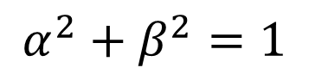
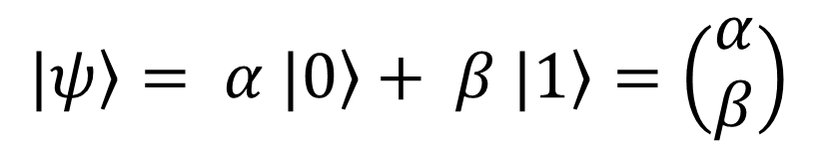
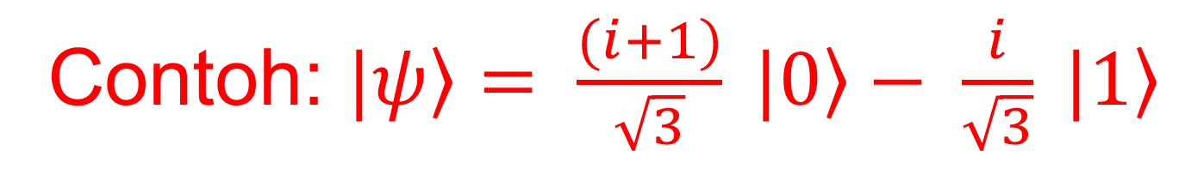
Representasi Qubit Tunggal
$$\left.|ψ\right\rangle = α \left.|0\right\rangle + β \left.|1\right\rangle =\left(\begin{matrix}α \\ β\end{matrix}\right)$$
Syarat :
$$α^{2}+β^{2}=1$$
dimana $α,β$adalah bilangan kompleks berbentuk $z=x+iy$, dengan $i=\sqrt{−1}$
Probabilitas untuk mendapatkan state $\left.|0\right\rangle$ = $α^{2}$
Probabilitas untuk mendapatkan state $\left.|1\right\rangle$ = $β^{2}$
Contoh: $\left.|ψ\right\rangle = \frac{(i+1)}{\sqrt{3}} \left.|0\right\rangle − \frac{i}{\sqrt{3}} \left.|1\right\rangle$

Slide 6
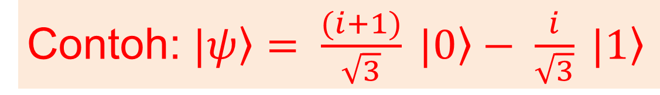
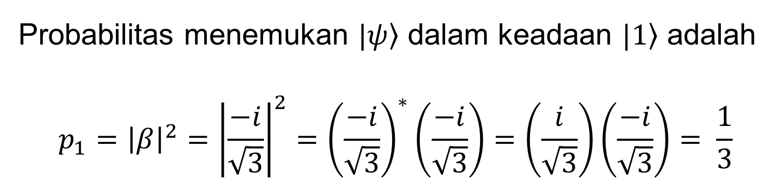
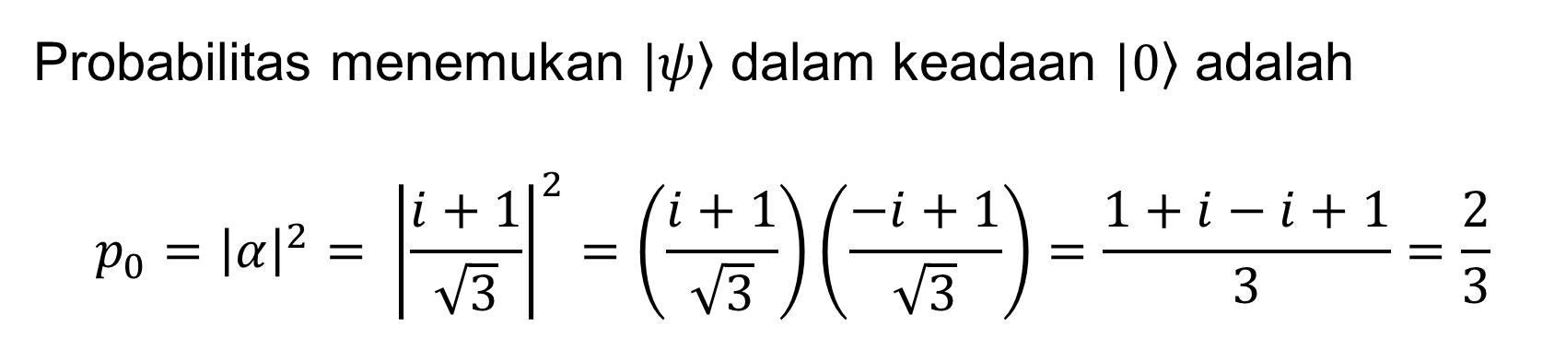
Pengukuran Qubit Tunggal
Ketika state Qubit |ψ⟩ diukur,
Probabilitas untuk mendapatkan state $\left.|0\right\rangle$ = $α^{2}$
Contoh: $\left.|ψ\right\rangle = \frac{(i+1)}{\sqrt{3}} \left.|0\right\rangle − \frac{i}{\sqrt{3}} \left.|1\right\rangle$
Probabilitas untuk mendapatkan state $\left.|1\right\rangle$ = $β^{2}$
Probabilitas menemukan $\left.|ψ\right\rangle$ dalam keadaan $\left.|0\right\rangle$ adalah
$$p_{0}={\left|α\right|}^{2}= {\left|\frac{i+1}{\sqrt{3}}\right|}^{2}=\left(\frac{i+1}{\sqrt{3}}\right)\left(\frac{−i+1}{\sqrt{3}}\right)=\frac{1+i−i+1}{3}=\frac{2}{3}$$
Probabilitas menemukan $\left.|ψ\right\rangle$ dalam keadaan $\left.|1\right\rangle$ adalah
$$p_{1}={{\left|β\right|}^{2}=\left|\frac{−i}{\sqrt{3}}\right|}^{2}={\left(\frac{−i}{\sqrt{3}}\right)}^{∗}\left(\frac{−i}{\sqrt{3}}\right)=\left(\frac{i}{\sqrt{3}}\right)\left(\frac{−i}{\sqrt{3}}\right)= \frac{1}{3}$$
verifikasi jumlah probabilitas : $p_{0}+p_{1}={\left|α\right|}^{2}+ {\left|β\right|}^{2}= \frac{2}{3}+ \frac{1}{3}=1$

Slide 7
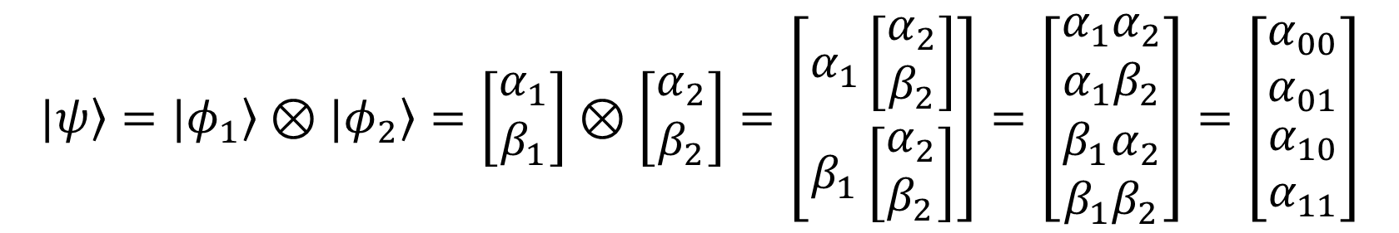
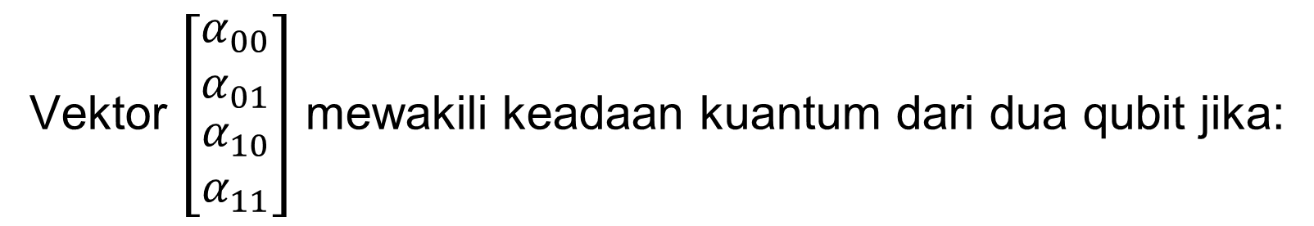
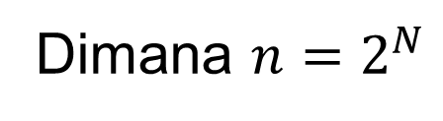
Representasi Qubit Ganda
Jika diberikan dua qubit terpisah, $|\left.φ_{1}\right\rangle =\left[\begin{matrix}α_{1} \\ β_{1}\end{matrix}\right]$ dan $|\left.φ_{2}\right\rangle =\left[\begin{matrix}α_{2} \\ β_{2}\end{matrix}\right]$, keadaan dua qubit yang bersesuaian diberikan oleh $|\left.ψ\right\rangle$, yaitu produk tensor $|\left.φ_{1}\right\rangle ⊗|\left.φ_{2}\right\rangle$ yang didefinisikan sebagai berikut.
$$|\left.ψ\right\rangle =|\left.φ_{1}\right\rangle ⊗|\left.φ_{2}\right\rangle =\left[\begin{matrix}α_{1} \\ β_{1}\end{matrix}\right]⊗\left[\begin{matrix}α_{2} \\ β_{2}\end{matrix}\right]=\left[\begin{matrix}α_{1}\left[\begin{matrix}α_{2} \\ β_{2}\end{matrix}\right] \\ β_{1}\left[\begin{matrix}α_{2} \\ β_{2}\end{matrix}\right]\end{matrix}\right]=\left[\begin{matrix}α_{1}α_{2} \\ α_{1}β_{2} \\ \begin{matrix}β_{1}α_{2} \\ β_{1}β_{2}\end{matrix}\end{matrix}\right]=\left[\begin{matrix}α_{00} \\ α_{01} \\ \begin{matrix}α_{10} \\ α_{11}\end{matrix}\end{matrix}\right]$$
Vektor $\left[\begin{matrix}α_{00} \\ α_{01} \\ \begin{matrix}α_{10} \\ α_{11}\end{matrix}\end{matrix}\right]$ mewakili keadaan kuantum dari dua qubit jika:
$${\left|α_{00}\right|}^{2}+{\left|α_{01}\right|}^{2}+{\left|α_{10}\right|}^{2}+{\left|α_{11}\right|}^{2}=1$$
Secara umum, keadaan dua Qubit dapat ditulis sebagai :
${|\left.ψ\right\rangle =}^{ }α_{00}|\left.00\right\rangle +α_{01}|\left.01\right\rangle$+$α_{10}|\left.10\right\rangle$+$α_{11}|\left.11\right\rangle$ = $α_{0}|\left.0\right\rangle +α_{1}|\left.1\right\rangle$+$α_{2}|\left.2\right\rangle$+$α_{3}|\left.3\right\rangle$
Keadaan N-Qubit dapat ditulis sebagai :
${|\left.ψ\right\rangle =}^{ }α_{0}|\left.0\right\rangle +α_{1}|\left.1\right\rangle$+$α_{2}|\left.2\right\rangle$+$α_{3}|\left.3\right\rangle$ +…. + $α_{n−1}|\left.n−1\right\rangle$
Dimana $n=2^{N}$

Slide 8
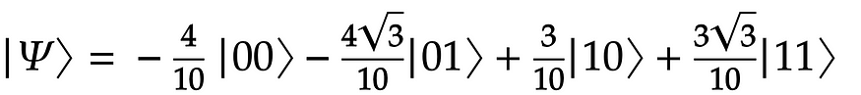
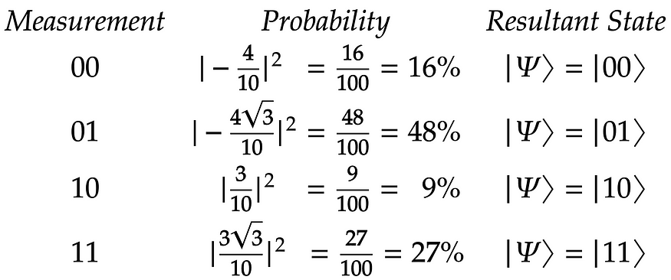
Pengukuran Qubit Ganda
Misalkan kita memiliki dua Qubit dengan status berikut :
Pengukuran Kuantum Qubit Penuh
Probabilitas dan status resultan untuk mengukur |00⟩ , |01⟩ , |10⟩ , dan |11⟩ masing-masing adalah 16%, 48%, 9%, dan 27%.

Slide 9
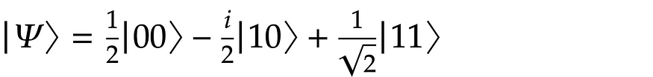
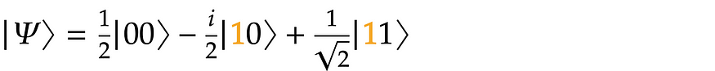
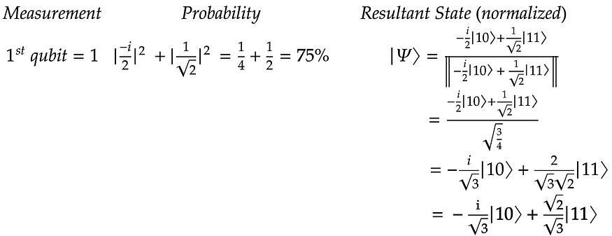
Pengukuran Qubit Ganda
Misalkan kita memiliki dua Qubit dengan status berikut :
Pengukuran Kuantum Qubit Parsial
Berikut ini adalah pengukuran qubit pertama untuk mendapatkan Qubit pertama = 1. Untuk melakukannya, kita hanya perlu memperhatikan status |10⟩ , dan |11⟩ yang memiliki qubit pertama = 1 (disorot di bawah).

Slide 10
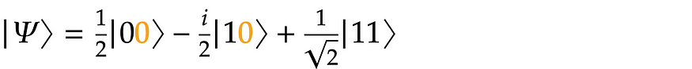
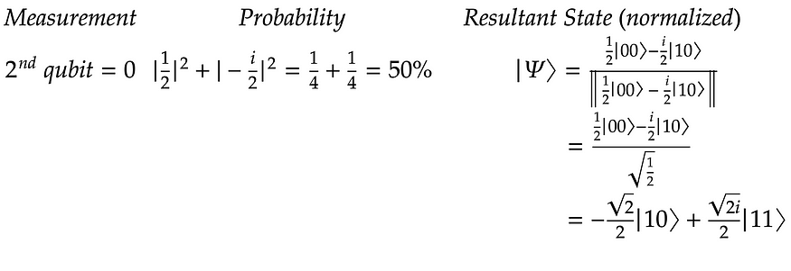
Pengukuran Qubit Ganda
Misalkan kita memiliki dua Qubit dengan status berikut :
Pengukuran Kuantum Qubit Parsial
Pengukuran untuk mendapatkan Qubit kedua = 0. Untuk melakukannya, kita hanya perlu memperhatikan status |00⟩ dan |10⟩ yang memiliki Qubit kedua = 0 (disorot di bawah).

Slide 11
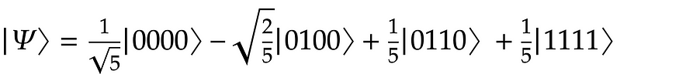
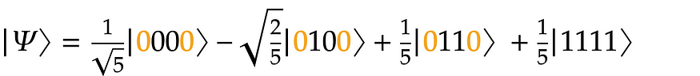
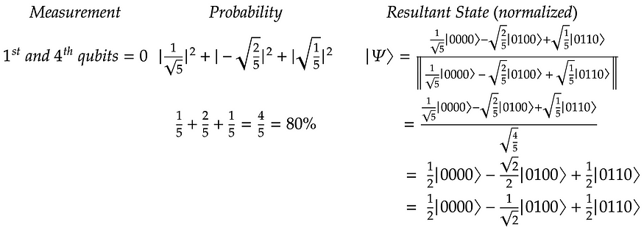
Pengukuran Qubit Ganda
Misalkan kita memiliki dua Qubit dengan status berikut :
Pengukuran Kuantum Qubit Parsial
Pengukuran Qubit pertama dan Qubit keempat sehingga didapat Qubit pertama =0 dan Qubit keempat= 0. Untuk melakukannya kita hanya perlu memperhatikan |0000⟩, |0100⟩, dan |0110⟩ yang memiliki qubit pertama dan keempat = 0 (disorot di bawah).

Slide 12
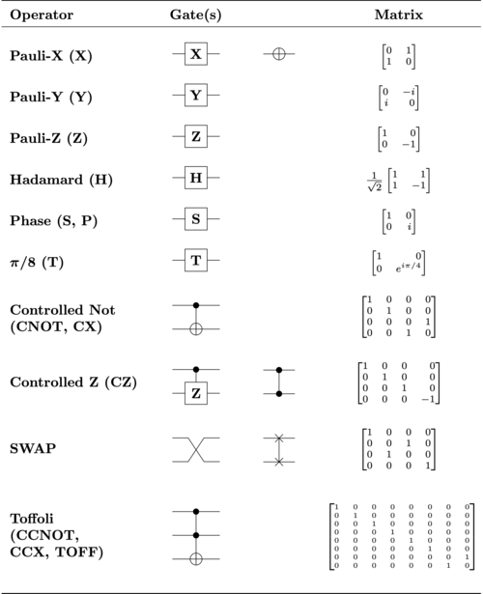
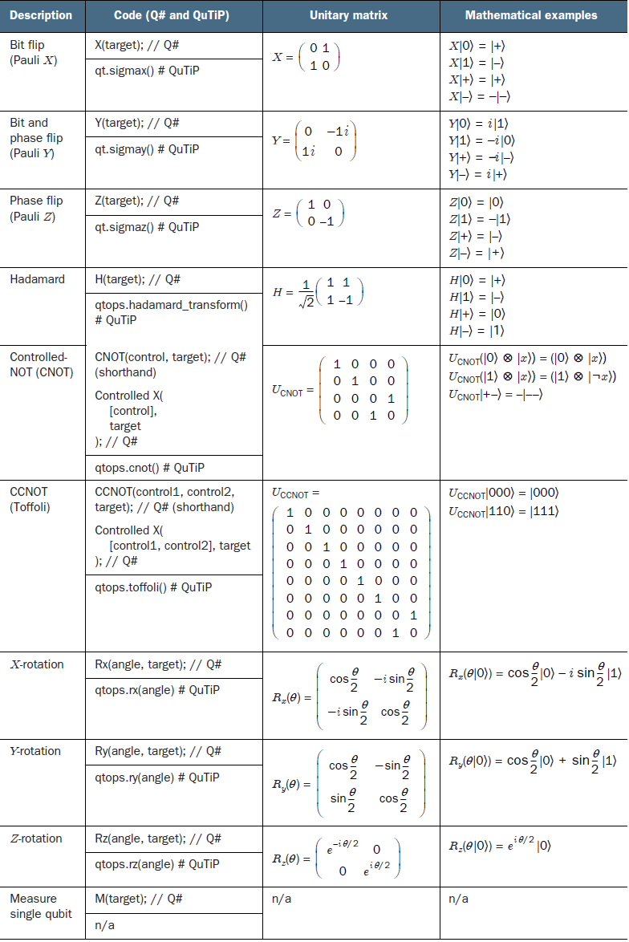
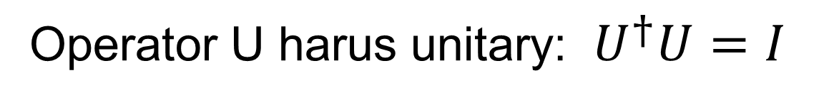
Operasi pada Qubit Tunggal
Single qubit operator U beroperasi pada satu qubit dan digunakan untuk memanipulasi qubit, misalnya membuat superposisi atau melakukan rotasi.
Operator U harus unitary: $U^{†}U=I$
Single-Qubit Gates Operator

Slide 13
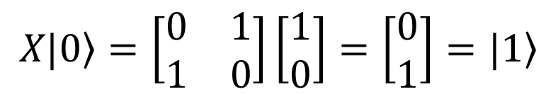
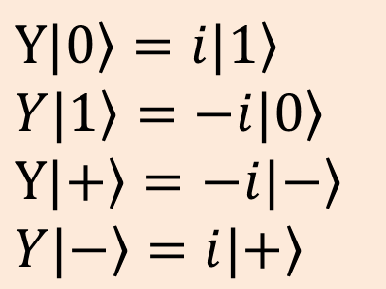
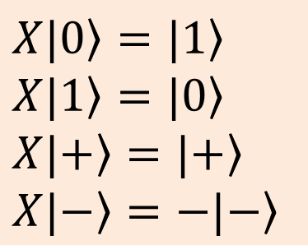
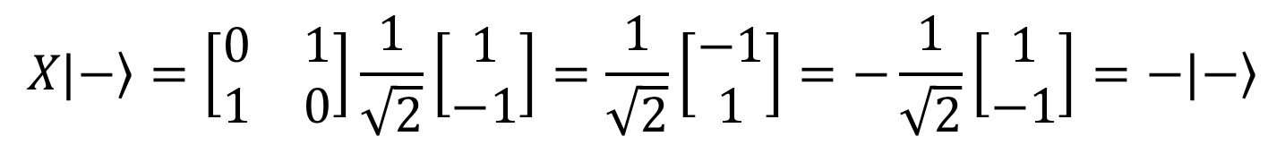
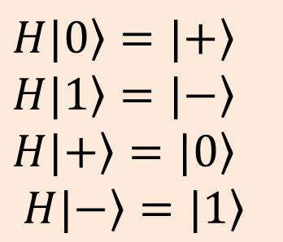
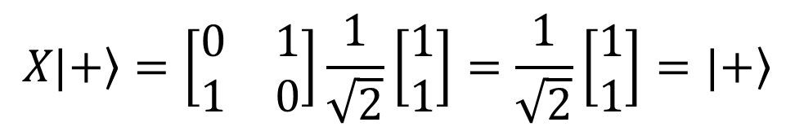
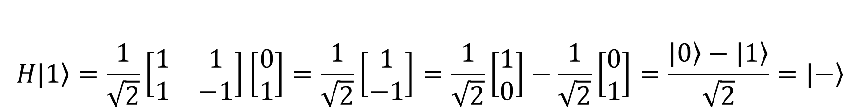
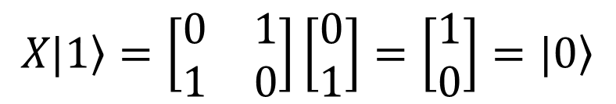
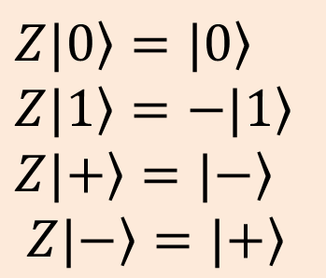
Operasi pada Qubit Tunggal
$$X|\left.0\right\rangle =|\left.1\right\rangle \\ X|\left.1\right\rangle =|\left.0\right\rangle$$
$$X|\left.+\right\rangle =|\left.+\right\rangle$$
$$X|\left.−\right\rangle =−|\left.−\right\rangle$$
$$H|\left.0\right\rangle =|\left.+\right\rangle \\ H|\left.1\right\rangle =|\left.−\right\rangle$$
$$H|\left.+\right\rangle =|\left.0\right\rangle$$
$$H|\left.−\right\rangle =|\left.1\right\rangle$$
$$H|\left.0\right\rangle =\frac{1}{\sqrt{2}}\left[\begin{matrix}1 & 1 \\ 1 & −1\end{matrix}\right]\left[\begin{matrix}1 \\ 0\end{matrix}\right]=\frac{1}{\sqrt{2}}\left[\begin{matrix}1 \\ 1\end{matrix}\right]=\frac{1}{\sqrt{2}}\left[\begin{matrix}1 \\ 0\end{matrix}\right]+\frac{1}{\sqrt{2}}\left[\begin{matrix}0 \\ 1\end{matrix}\right]=\frac{|\left.0\right\rangle +|\left.1\right\rangle }{\sqrt{2}}=|\left.+\right\rangle$$
$$H|\left.1\right\rangle =\frac{1}{\sqrt{2}}\left[\begin{matrix}1 & 1 \\ 1 & −1\end{matrix}\right]\left[\begin{matrix}0 \\ 1\end{matrix}\right]=\frac{1}{\sqrt{2}}\left[\begin{matrix}1 \\ −1\end{matrix}\right]=\frac{1}{\sqrt{2}}\left[\begin{matrix}1 \\ 0\end{matrix}\right]−\frac{1}{\sqrt{2}}\left[\begin{matrix}0 \\ 1\end{matrix}\right]=\frac{|\left.0\right\rangle −|\left.1\right\rangle }{\sqrt{2}}=|\left.−\right\rangle$$
$$Y|\left.0\right\rangle =i|\left.1\right\rangle \\ Y|\left.1\right\rangle =−i|\left.0\right\rangle$$
$$Y|\left.+\right\rangle =−i|\left.−\right\rangle$$
$$Y|\left.−\right\rangle =i|\left.+\right\rangle$$
$$Z|\left.0\right\rangle =|\left.0\right\rangle \\ Z|\left.1\right\rangle =−|\left.1\right\rangle$$
$$Z|\left.+\right\rangle =|\left.−\right\rangle$$
$$Z|\left.−\right\rangle =|\left.+\right\rangle$$
$$H|\left.−\right\rangle =H\left(\frac{|\left.0\right\rangle −|\left.1\right\rangle }{\sqrt{2}}\right)=\frac{1}{\sqrt{2}}\left(H\left|\left.0\right\rangle −H\right|\left.1\right\rangle \right)=\frac{1}{\sqrt{2}}\left(\frac{|\left.0\right\rangle +|\left.1\right\rangle }{\sqrt{2}}−\frac{|\left.0\right\rangle −|\left.1\right\rangle }{\sqrt{2}}\right)=|\left.1\right\rangle$$
$$H|\left.+\right\rangle =H\left(\frac{|\left.0\right\rangle +|\left.1\right\rangle }{\sqrt{2}}\right)=\frac{1}{\sqrt{2}}\left(H\left|\left.0\right\rangle +H\right|\left.1\right\rangle \right)=\frac{1}{\sqrt{2}}\left(\frac{|\left.0\right\rangle +|\left.1\right\rangle }{\sqrt{2}}+\frac{|\left.0\right\rangle −|\left.1\right\rangle }{\sqrt{2}}\right)=|\left.0\right\rangle$$
$$X|\left.0\right\rangle =\left[\begin{matrix}0 & 1 \\ 1 & 0\end{matrix}\right]\left[\begin{matrix}1 \\ 0\end{matrix}\right]=\left[\begin{matrix}0 \\ 1\end{matrix}\right]=|\left.1\right\rangle$$
$$X|\left.+\right\rangle =\left[\begin{matrix}0 & 1 \\ 1 & 0\end{matrix}\right]\frac{1}{\sqrt{2}}\left[\begin{matrix}1 \\ 1\end{matrix}\right]=\frac{1}{\sqrt{2}}\left[\begin{matrix}1 \\ 1\end{matrix}\right]=|\left.+\right\rangle$$
$$X|\left.1\right\rangle =\left[\begin{matrix}0 & 1 \\ 1 & 0\end{matrix}\right]\left[\begin{matrix}0 \\ 1\end{matrix}\right]=\left[\begin{matrix}1 \\ 0\end{matrix}\right]=|\left.0\right\rangle$$
$$X|\left.−\right\rangle =\left[\begin{matrix}0 & 1 \\ 1 & 0\end{matrix}\right]\frac{1}{\sqrt{2}}\left[\begin{matrix}1 \\ −1\end{matrix}\right]=\frac{1}{\sqrt{2}}\left[\begin{matrix}−1 \\ 1\end{matrix}\right]=−\frac{1}{\sqrt{2}}\left[\begin{matrix}1 \\ −1\end{matrix}\right]=−|\left.−\right\rangle$$

Slide 14
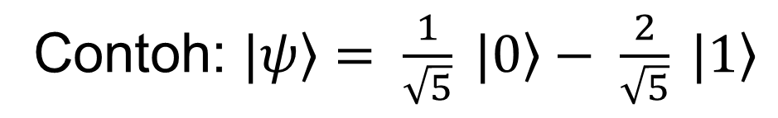
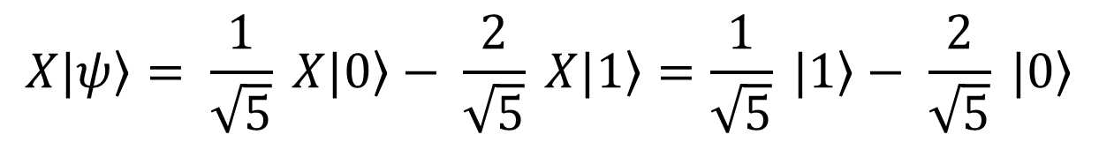
Operasi pada Qubit Tunggal
Contoh: $\left.|ψ\right\rangle = \frac{1}{\sqrt{5}} \left.|0\right\rangle − \frac{2}{\sqrt{5}} \left.|1\right\rangle$
$$\left.X|ψ\right\rangle = \frac{1}{\sqrt{5}} \left.X|0\right\rangle − \frac{2}{\sqrt{5}} \left.X|1\right\rangle =\frac{1}{\sqrt{5}} \left.|1\right\rangle − \frac{2}{\sqrt{5}} \left.|0\right\rangle$$
$$\left.XZ|ψ\right\rangle = \frac{1}{\sqrt{5}} \left.XZ|0\right\rangle − \frac{2}{\sqrt{5}} \left.XZ|1\right\rangle =\frac{1}{\sqrt{5}} \left.X|0\right\rangle +\frac{2}{\sqrt{5}} \left.X|1\right\rangle =\frac{1}{\sqrt{5}} \left.|1\right\rangle +\frac{2}{\sqrt{5}} \left.|0\right\rangle$$
$$\left.H|ψ\right\rangle = \frac{1}{\sqrt{5}} \left.H|0\right\rangle − \frac{2}{\sqrt{5}} \left.H|1\right\rangle =\frac{1}{\sqrt{5}} \frac{\left(\left.|1\right\rangle +\left.|0\right\rangle \right)}{\sqrt{2}}− \frac{2}{\sqrt{5}}\frac{\left(\left.|1\right\rangle −\left.|0\right\rangle \right)}{\sqrt{2}}=\frac{3}{\sqrt{10}}\left.|0\right\rangle −\frac{1}{\sqrt{10}}\left.|1\right\rangle$$

Slide 15
Operasi pada Qubit Ganda
Multiple Qubit gates beroperasi pada dua Qubit atau lebih dan digunakan untuk membuat keterikatan antar Qubit.

Slide 16
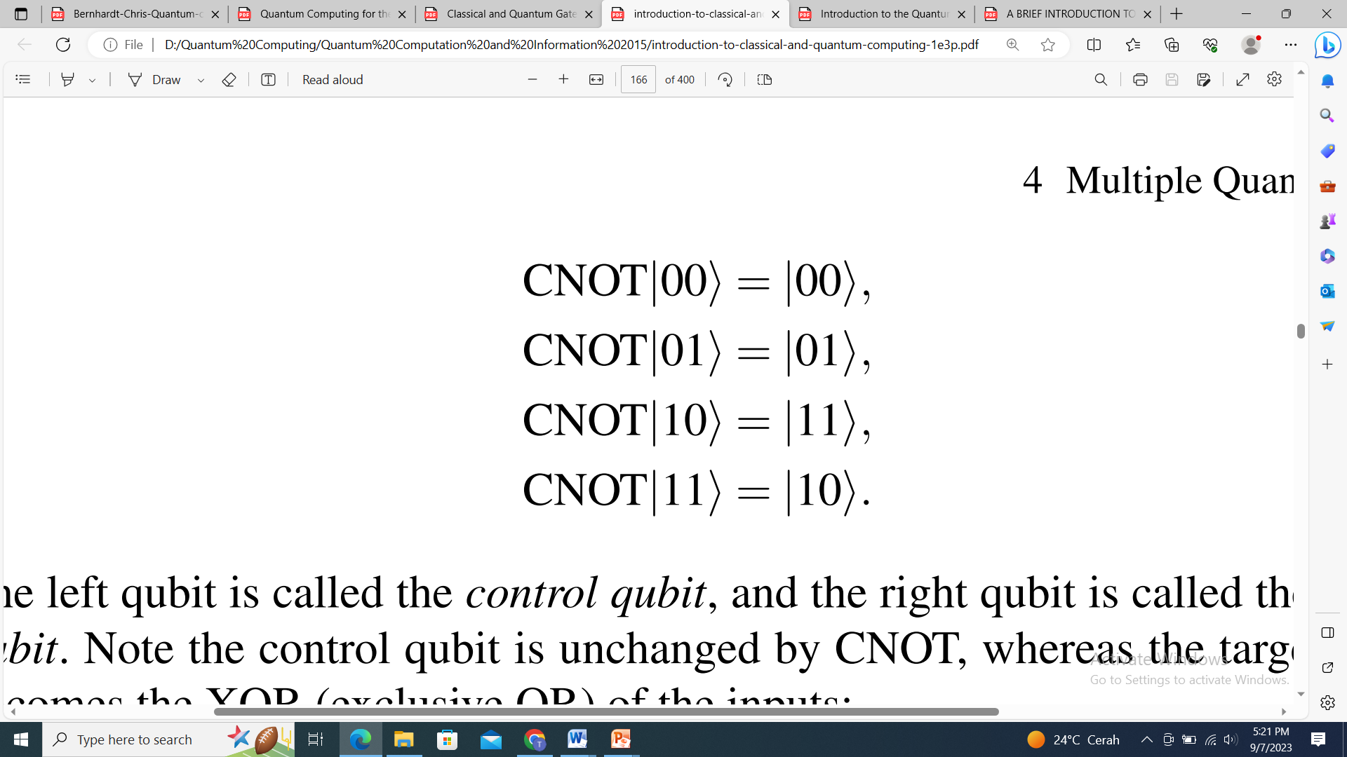
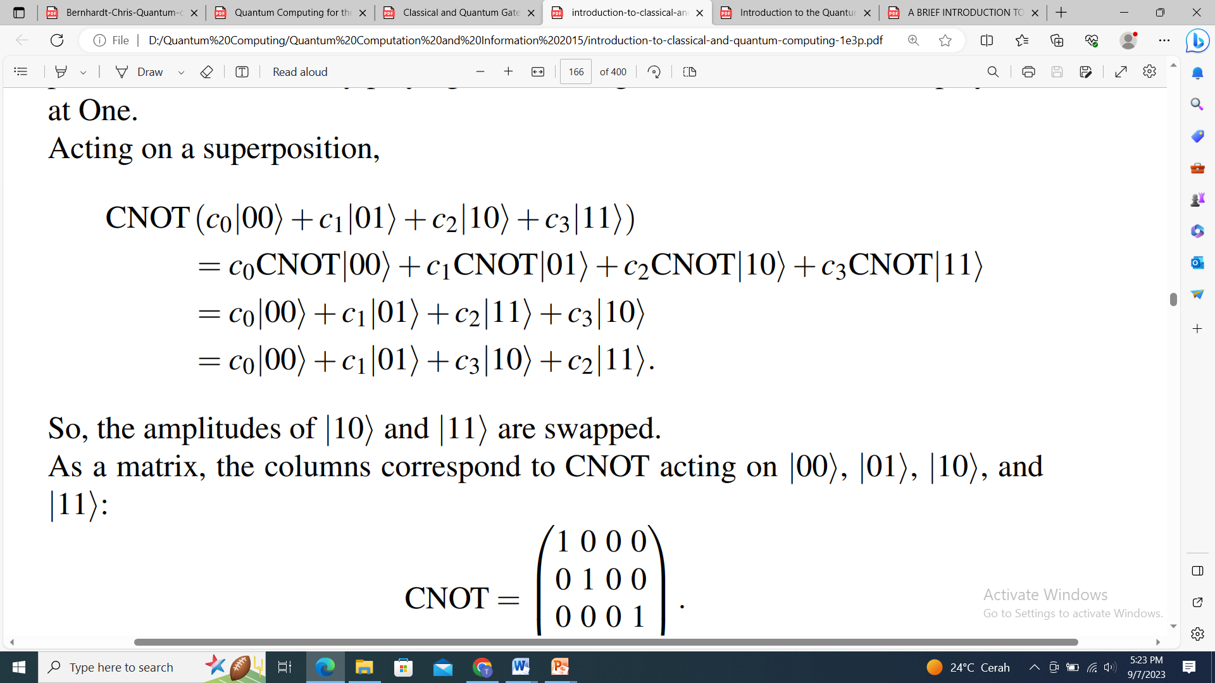
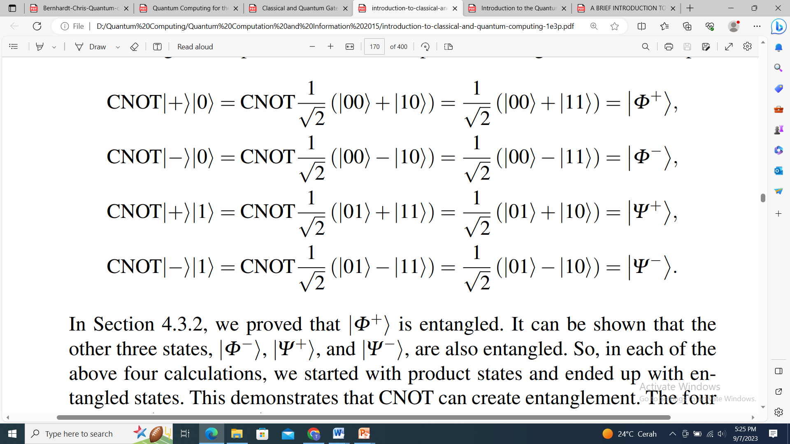
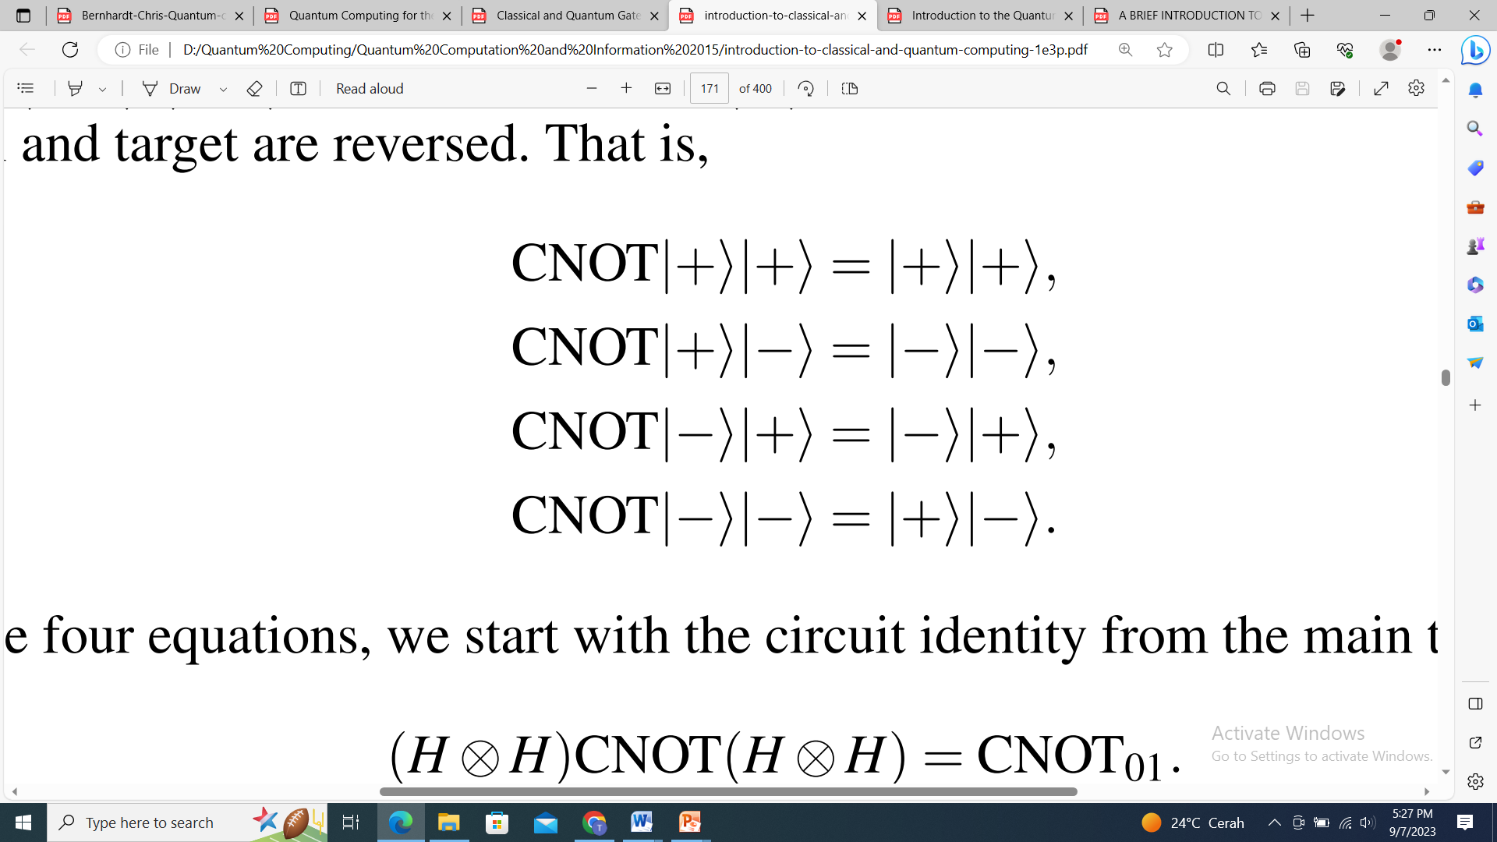
Operasi pada Qubit Ganda
The CNOT gate or controlled-NOT gate

Slide 17
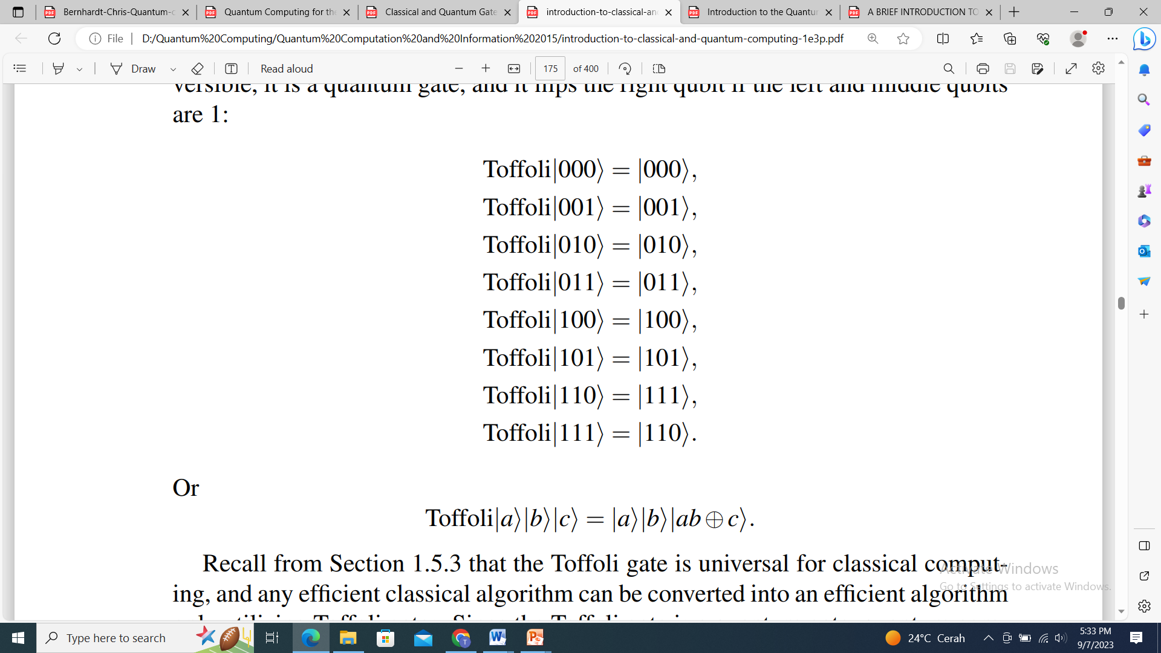
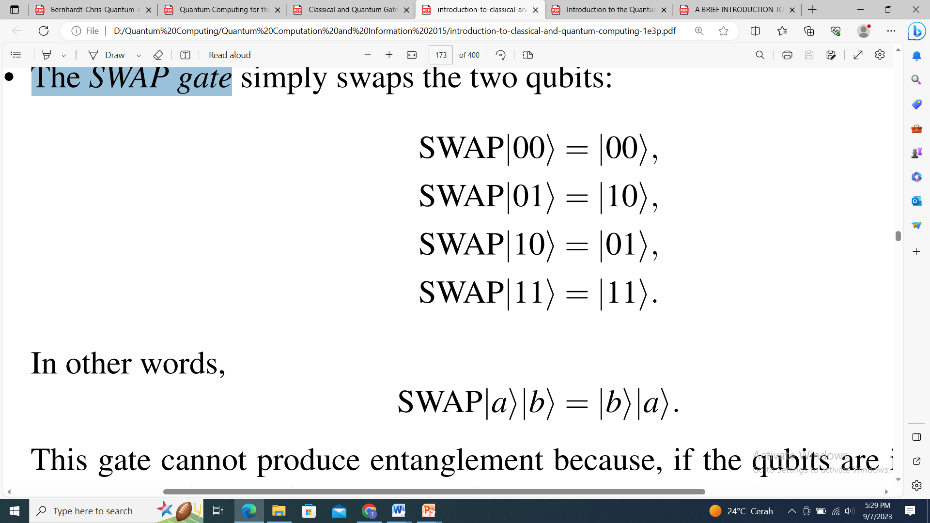
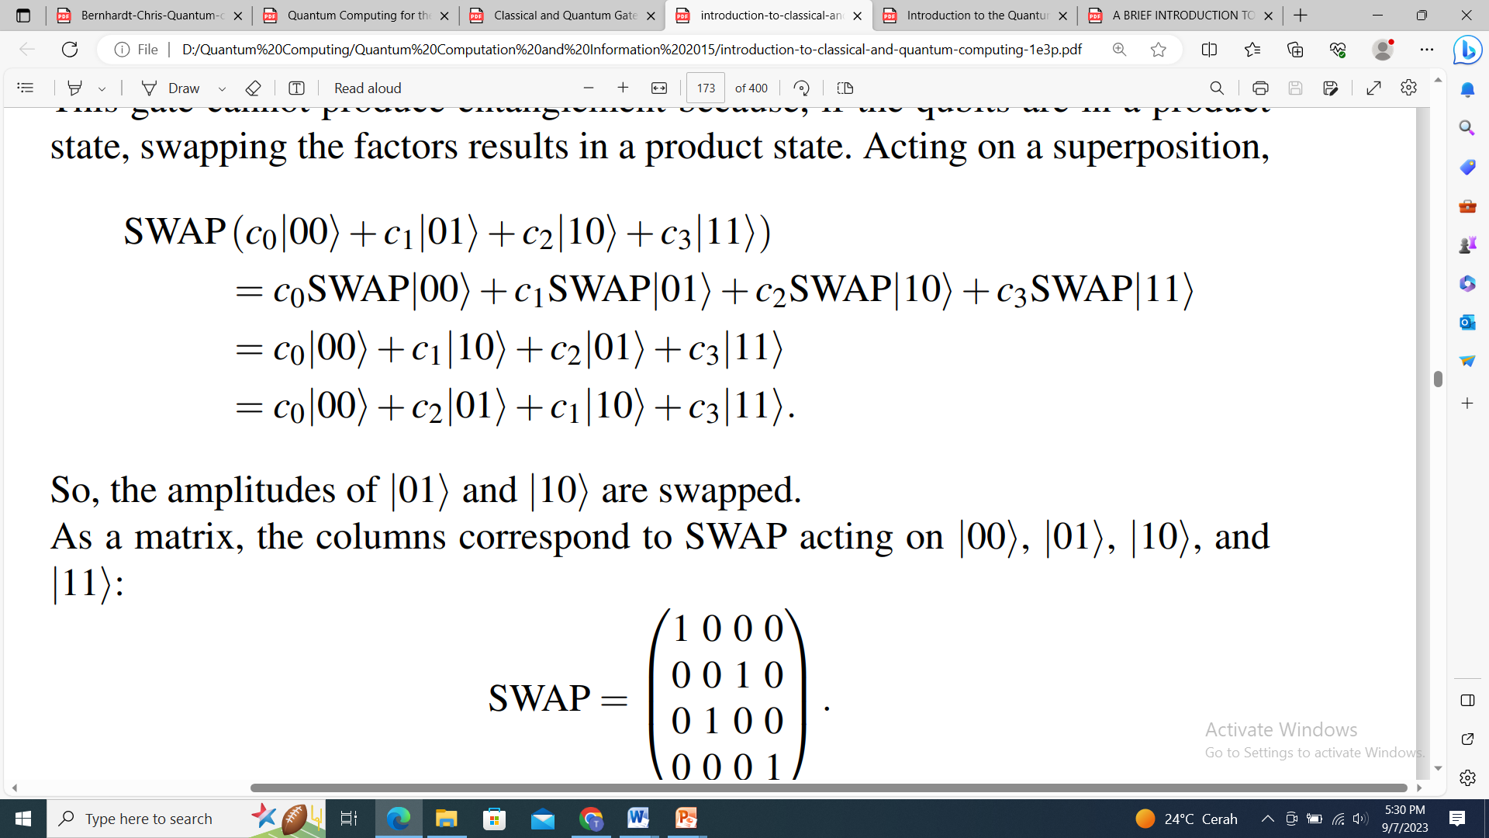
Operasi pada Qubit Ganda
The SWAP gate
Toffoli gate

Slide 18





Operasi pada Qubit Ganda
$$\left.|ψ\right\rangle = \frac{1}{\sqrt{10}} \left.|00\right\rangle − \frac{2}{\sqrt{10}} \left.|01\right\rangle +\frac{\sqrt{2}}{\sqrt{10}}\left.|10\right\rangle −\frac{\sqrt{3}}{\sqrt{10}}\left.|11\right\rangle$$
$$CX\left(SWAP\left.|ψ\right\rangle \right)=CX\left(\frac{1}{\sqrt{10}} \left.|00\right\rangle − \frac{2}{\sqrt{10}} \left.|10\right\rangle +\frac{\sqrt{2}}{\sqrt{10}}\left.|01\right\rangle −\frac{\sqrt{3}}{\sqrt{10}}\left.|11\right\rangle \right)$$
$$CX\left(SWAP\left.|ψ\right\rangle \right)=\frac{1}{\sqrt{10}} \left.|00\right\rangle − \frac{2}{\sqrt{10}} \left.|11\right\rangle +\frac{\sqrt{2}}{\sqrt{10}}\left.|01\right\rangle −\frac{\sqrt{3}}{\sqrt{10}}\left.|10\right\rangle$$
$$\left.|ψ\right\rangle = \frac{1}{\sqrt{10}} \left.|001\right\rangle − \frac{2}{\sqrt{10}} \left.|111\right\rangle +\frac{\sqrt{2}}{\sqrt{10}}\left.|110\right\rangle −\frac{\sqrt{3}}{\sqrt{10}}\left.|101\right\rangle$$
$$\left.Toffoli(|ψ\right\rangle )= \frac{1}{\sqrt{10}} \left.|001\right\rangle − \frac{2}{\sqrt{10}} \left.|110\right\rangle +\frac{\sqrt{2}}{\sqrt{10}}\left.|111\right\rangle −\frac{\sqrt{3}}{\sqrt{10}}\left.|101\right\rangle$$

Slide 19






TERIMA KASIH

